Slide 1
Clean Raw Data
Identify Data Issues
Clean with Power Query
Clean with Python
Clean with Gen AI

Slide 2
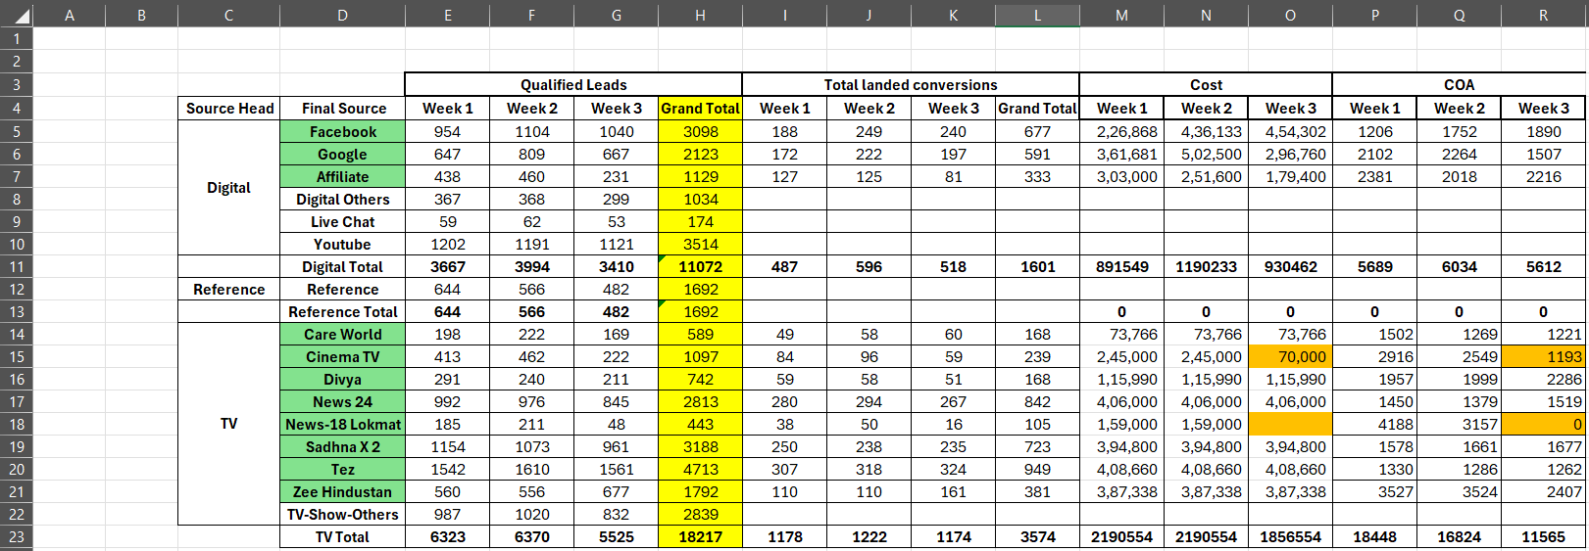
Clean Raw Data

Slide 3
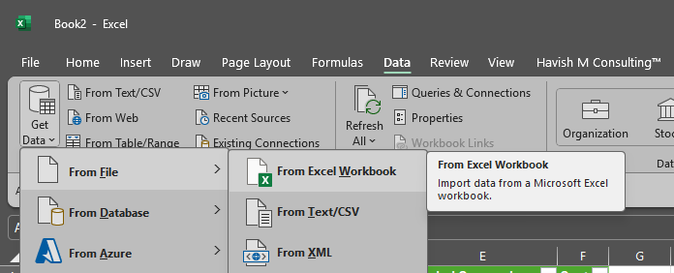
Clean Raw Data

Slide 4
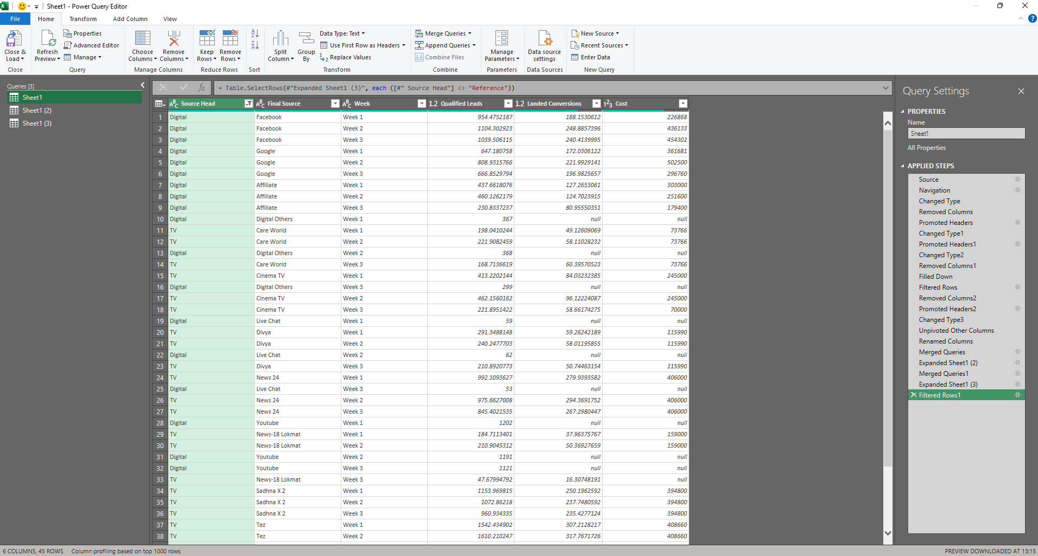
Clean Raw Data

Slide 5
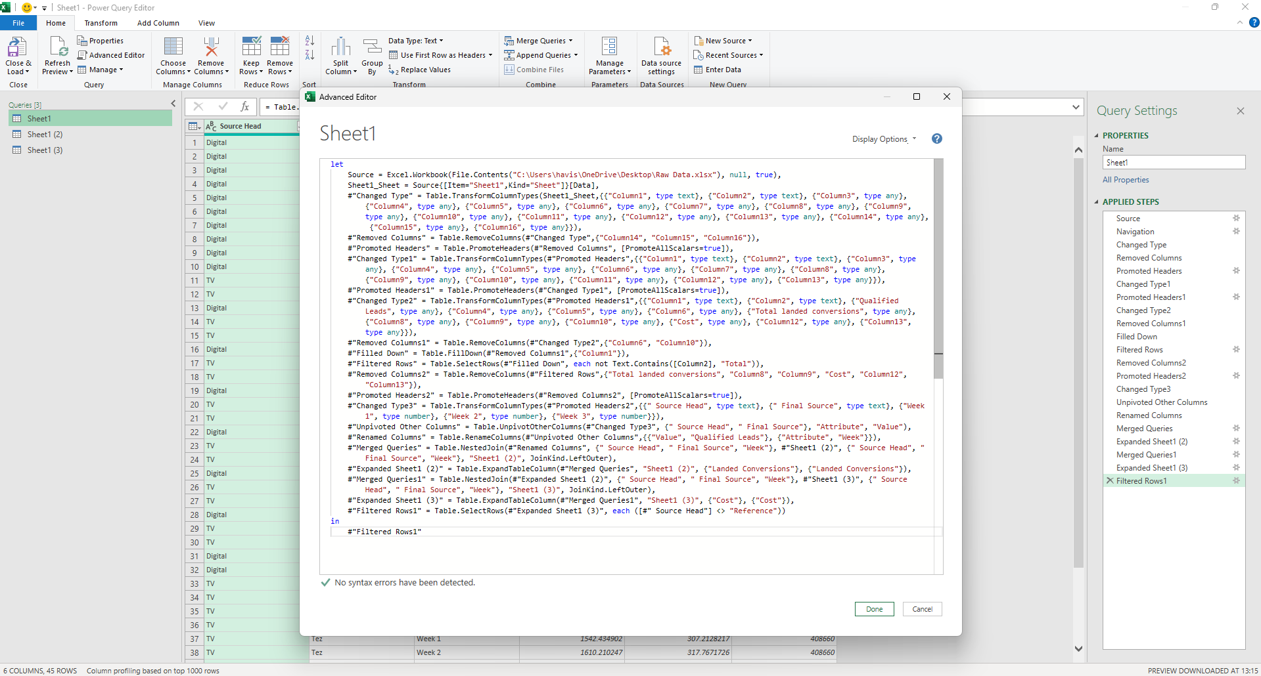
Clean Raw Data

Slide 6
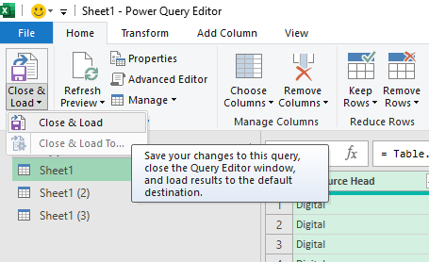
Clean Raw Data

Slide 7
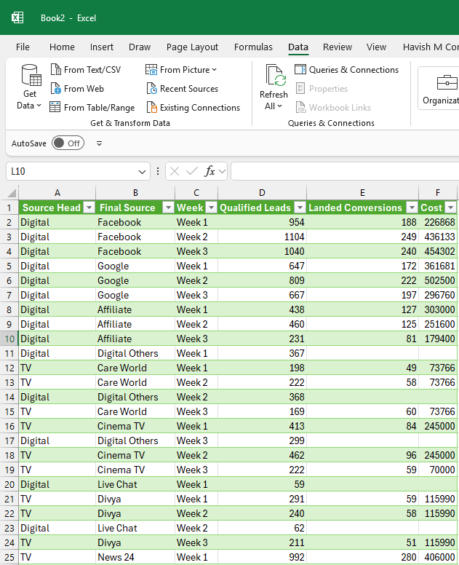
Clean Raw Data

Slide 8
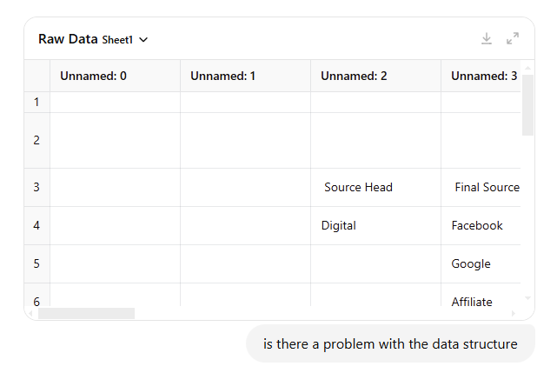
Clean Raw Data

Slide 9
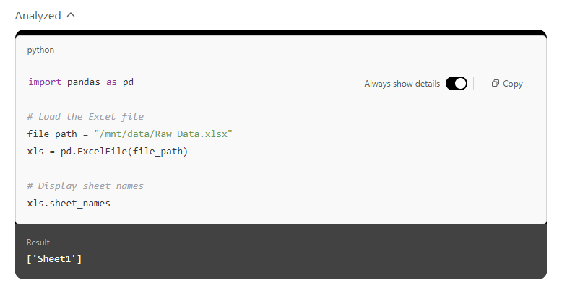
Clean Raw Data

Slide 10
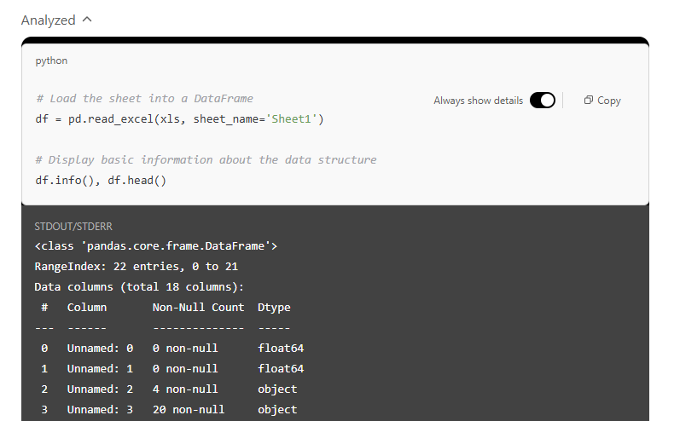
Clean Raw Data

Slide 11
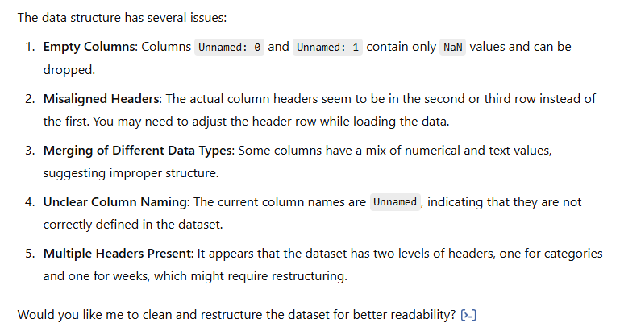
Clean Raw Data

Slide 12
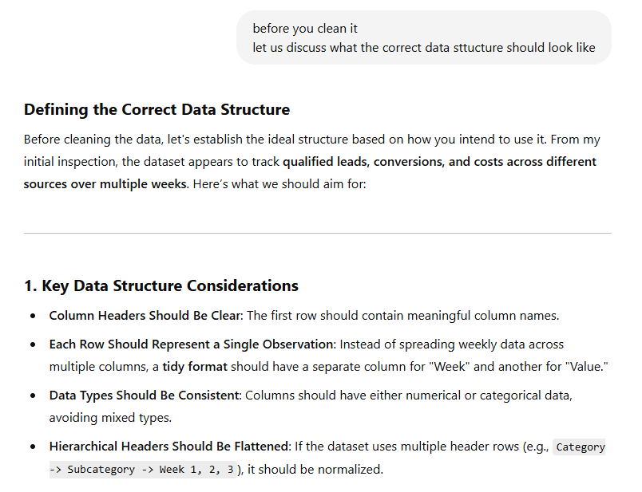
Clean Raw Data

Slide 13
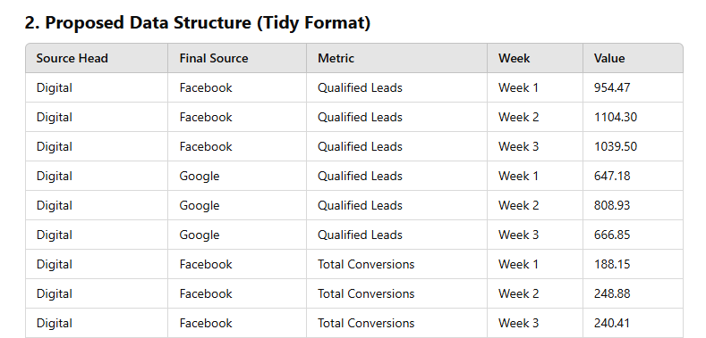
Clean Raw Data

Slide 14
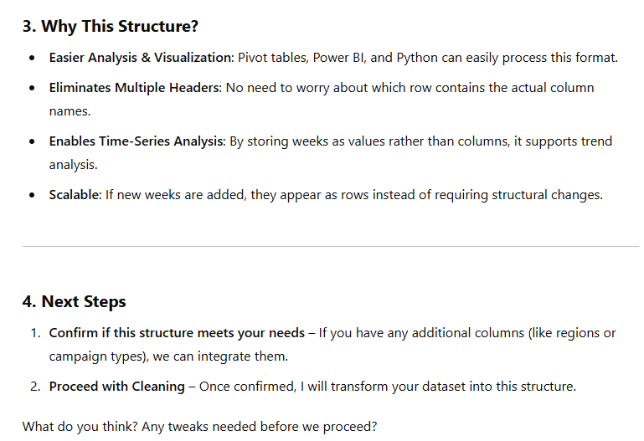
Clean Raw Data

Slide 15
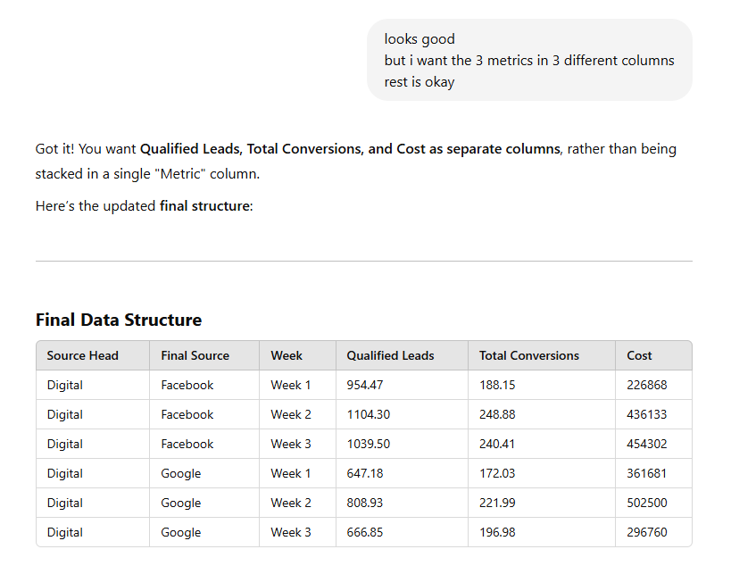
Clean Raw Data

Slide 16
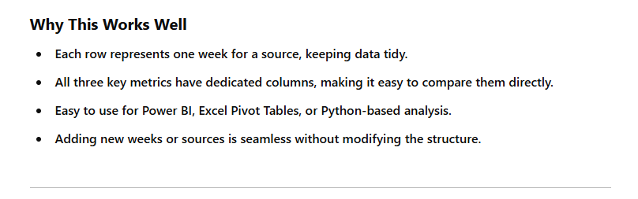
Clean Raw Data

Slide 17
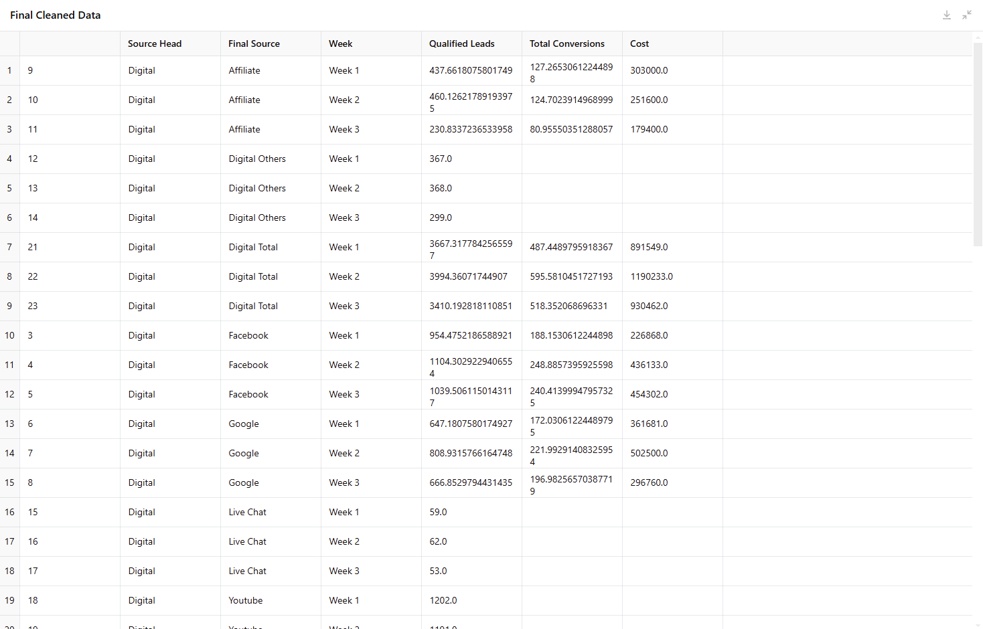
Clean Raw Data

Slide 18
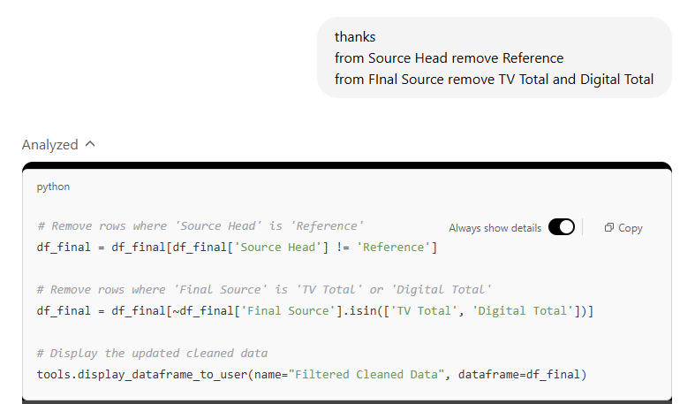
Clean Raw Data

Slide 19
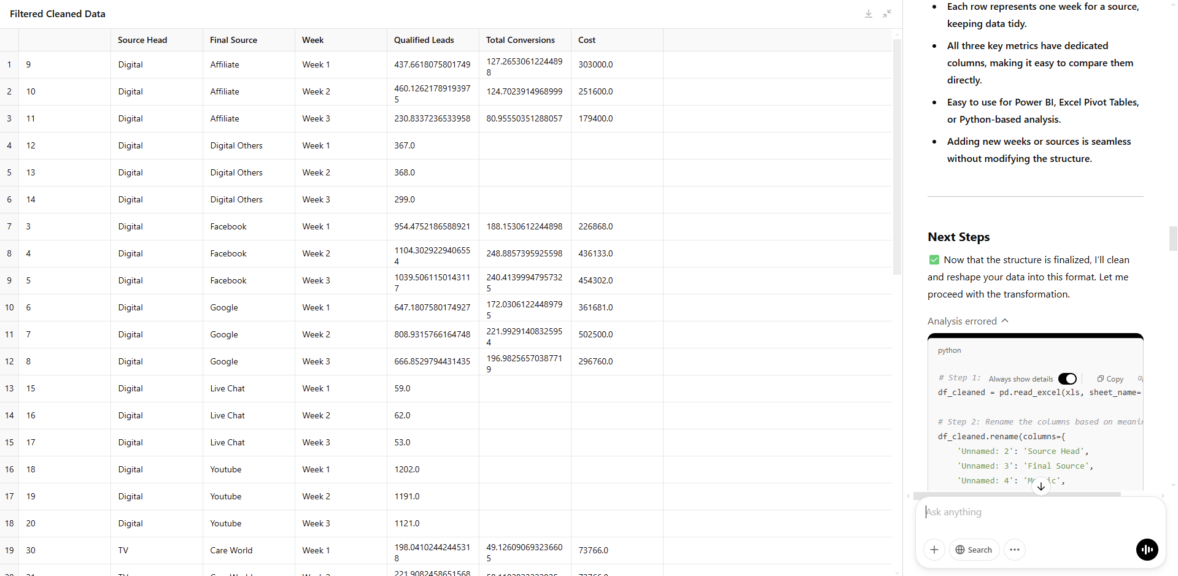
Clean Raw Data

Slide 20
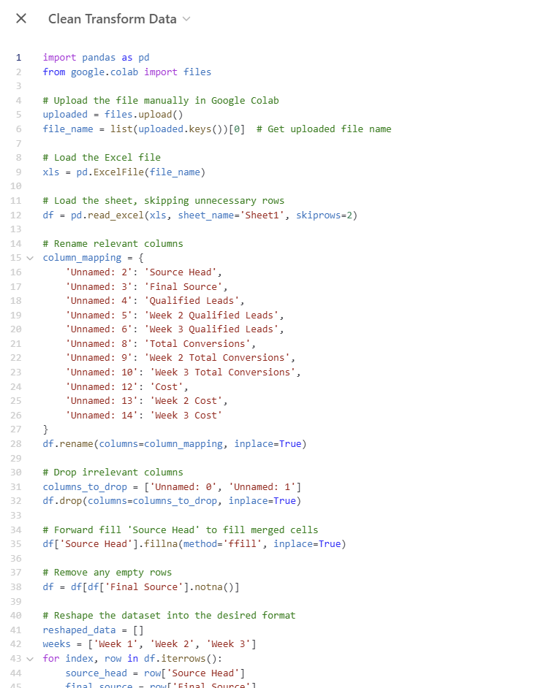
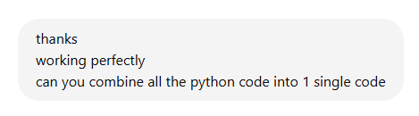
Clean Raw Data

Slide 21
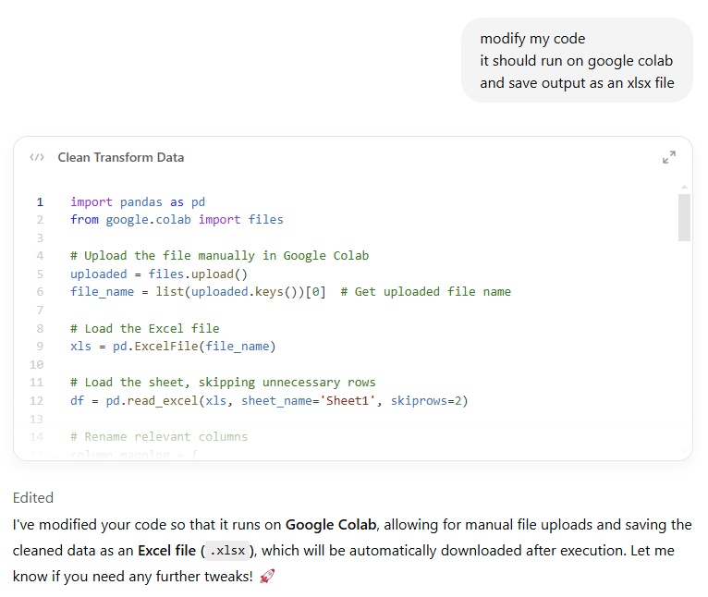
Clean Raw Data

Slide 22
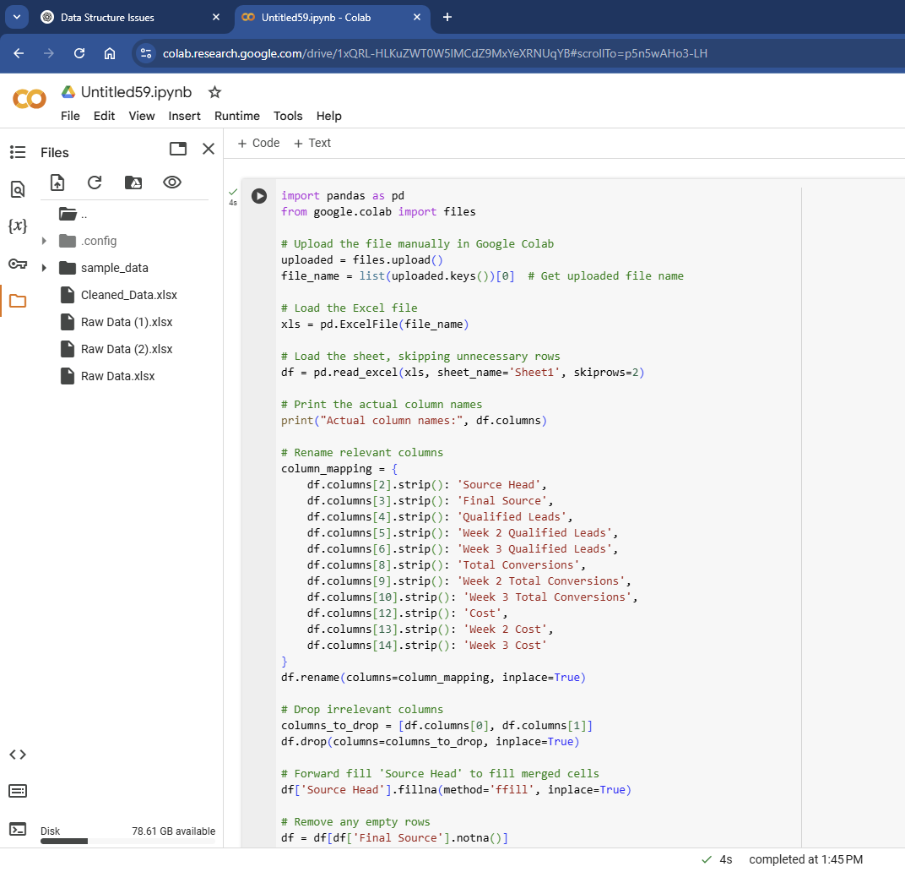
Clean Raw Data

Slide 23
Tableau Dashboard
Cost – Source
Cost by Source Head and Week
Cost - Source Head (Grand Total)
Cost - Source Head (Source Total)
Cost with Ref Line
Cost by Week
Week Wise CAC
CAC by Source
Conversion by Source
Conversion vs Cost by Source
Conversion by Source - Compared to Previous
Scatter CAC vs Conversion
Scatter CAC vs Conversion - Week+Source
Scatter CAC vs Conversion Quadrant
Tooltip
JIVA Marketing Channel Performance Analysis

Slide 24
Weighted Score
Excel
Tableau
Gen AI

Slide 25
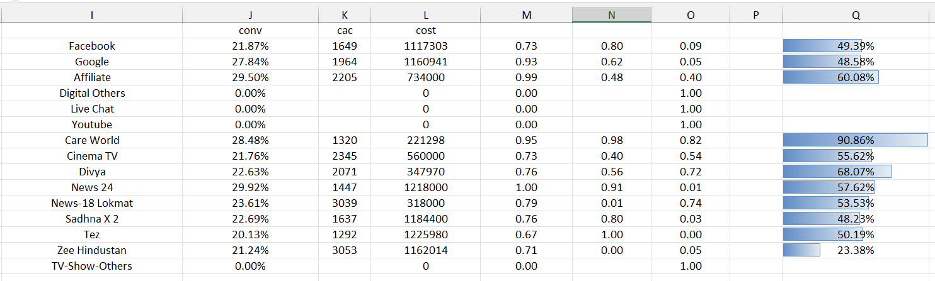
Weighted Score

Slide 26
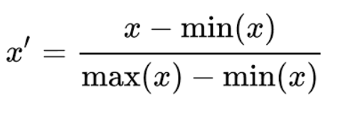
Weighted Score

Slide 27
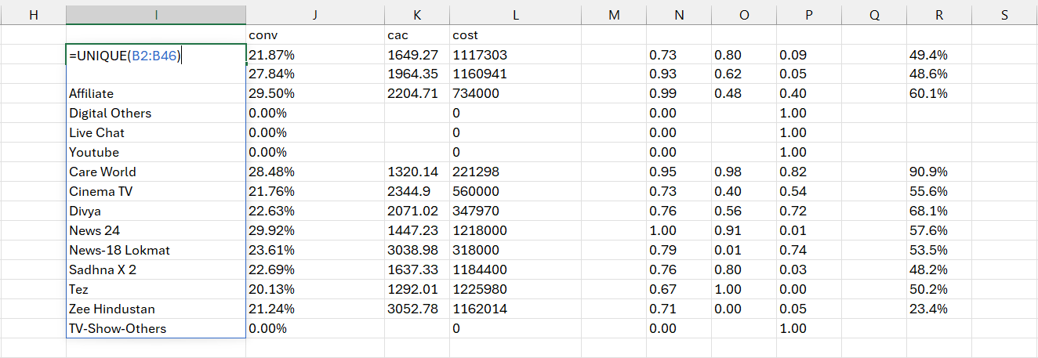
Weighted Score

Slide 28
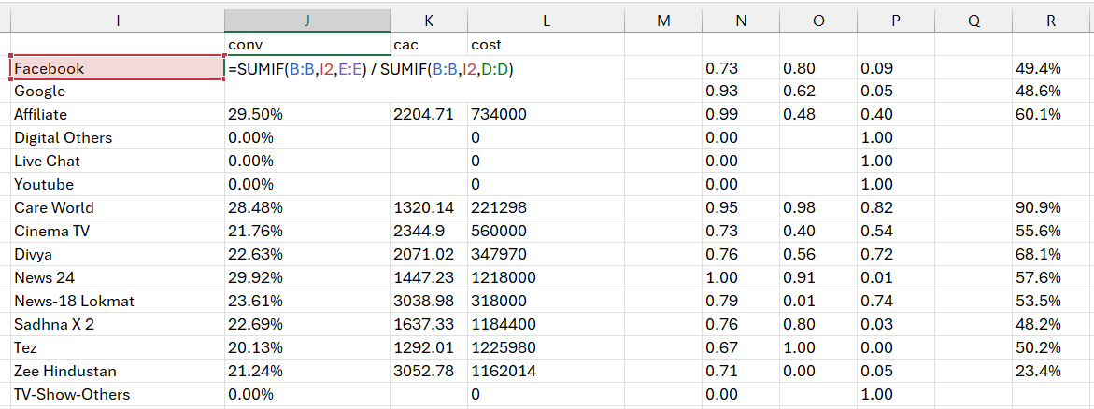
Weighted Score

Slide 29
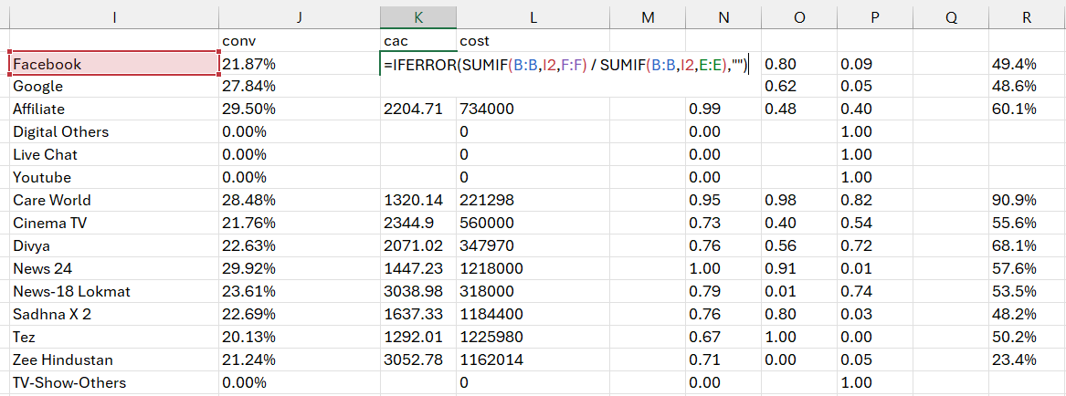
Weighted Score

Slide 30
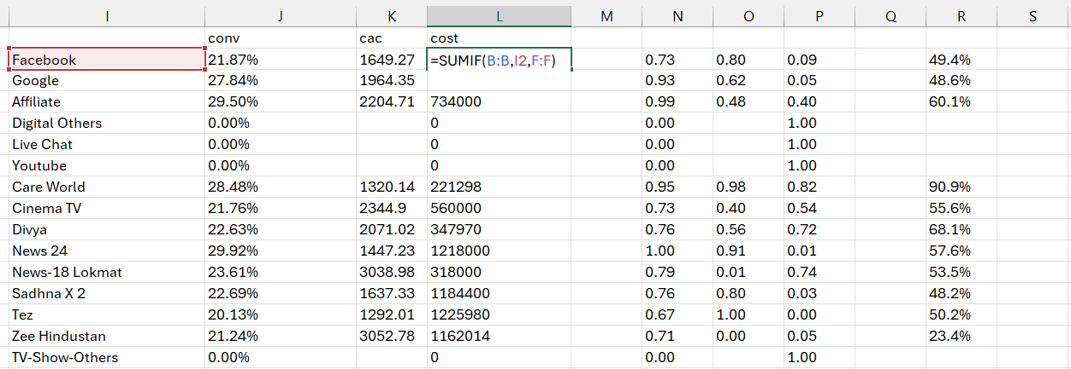
Weighted Score

Slide 31
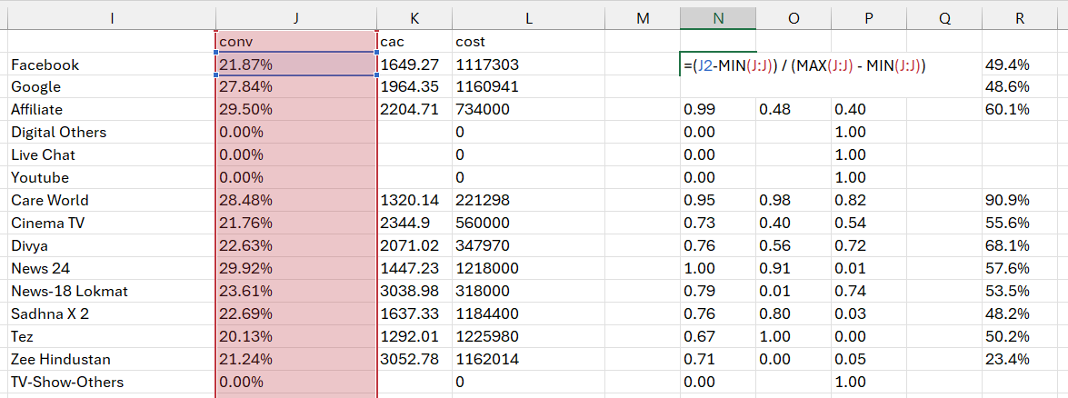
Weighted Score

Slide 32
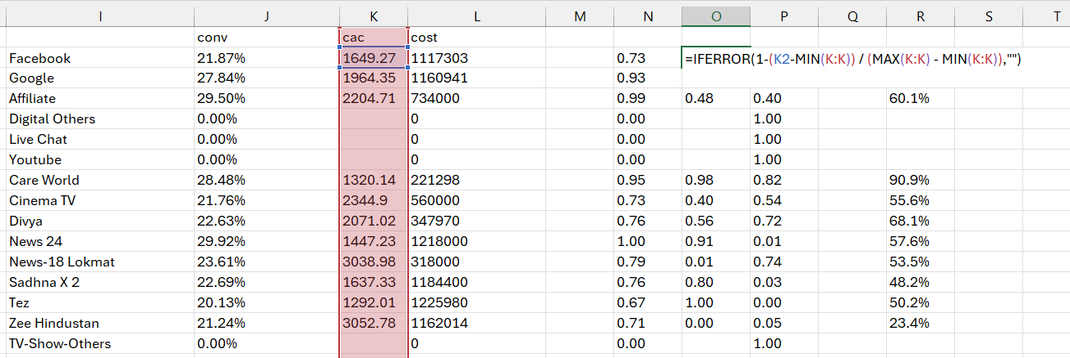
Weighted Score

Slide 33
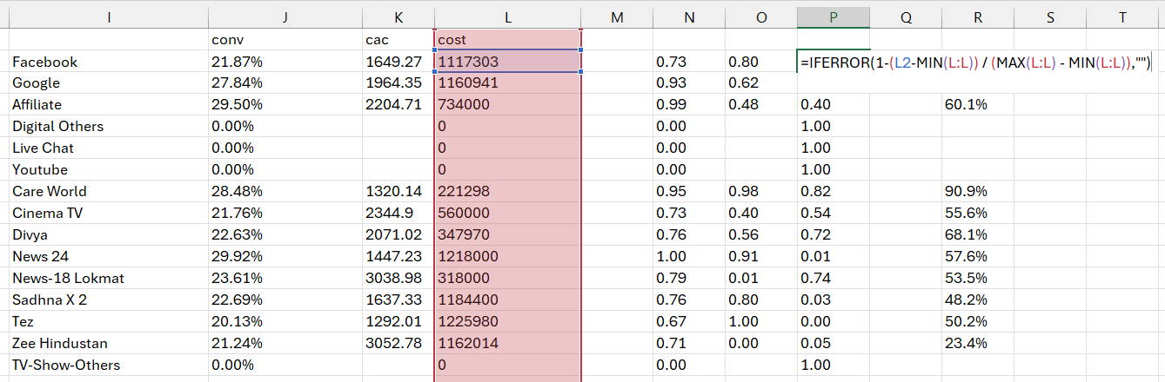
Weighted Score

Slide 34
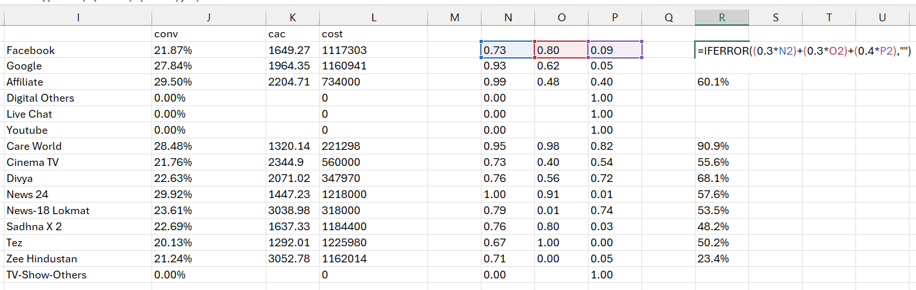
Weighted Score

Slide 35
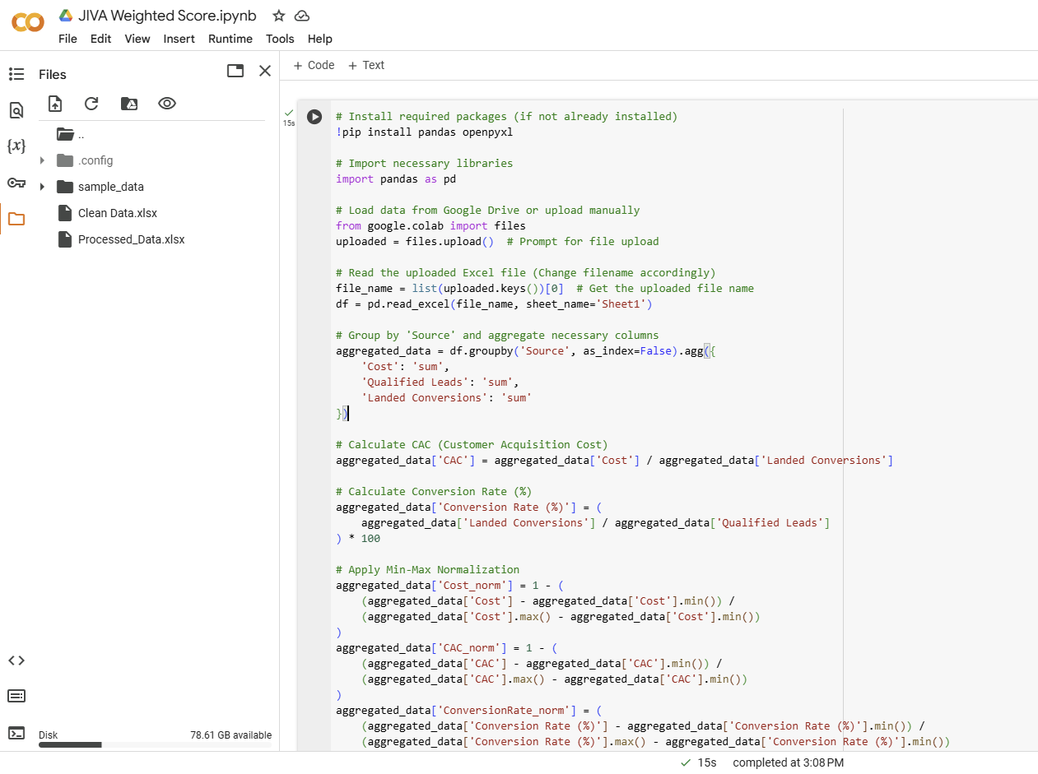
Weighted Score

Slide 36
Insights
Different Gen AI Tools

Slide 37

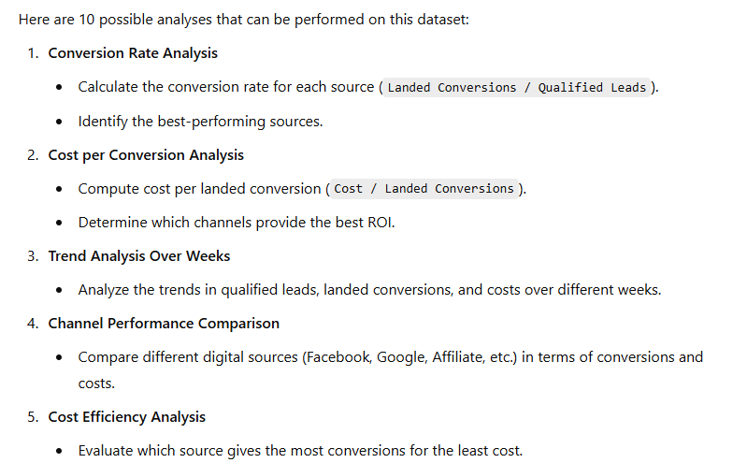
Insights

Slide 38
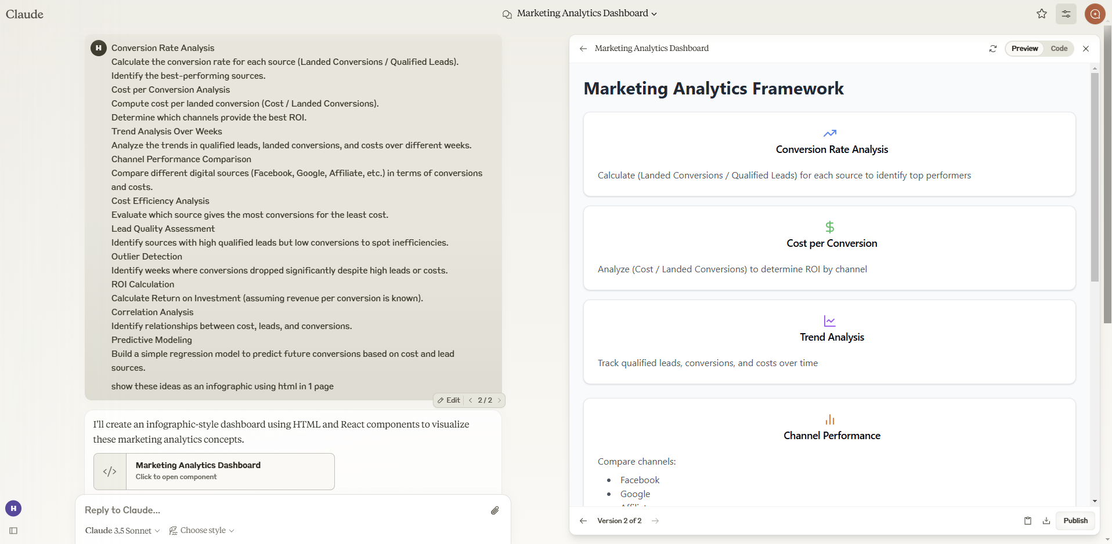
Insights

Slide 39
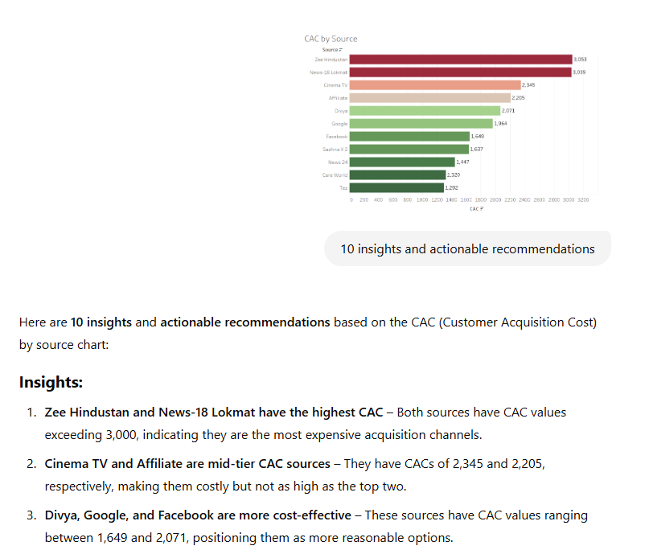
Insights

Slide 40
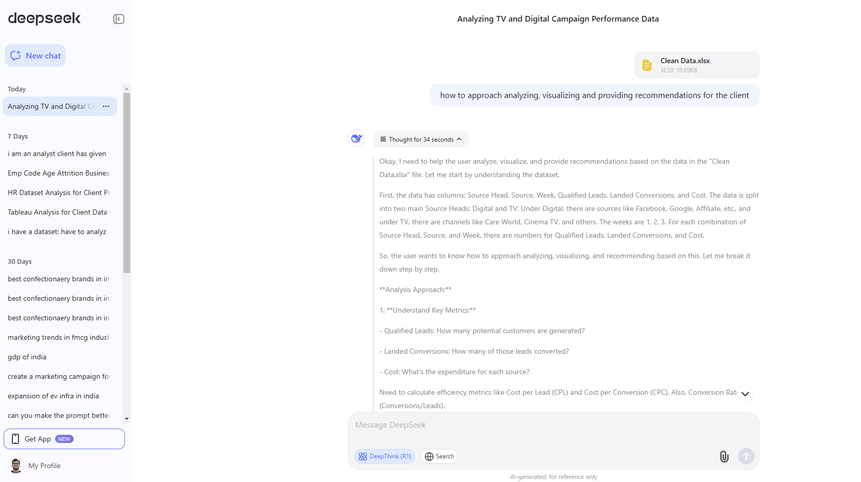
Insights

